Slide 1
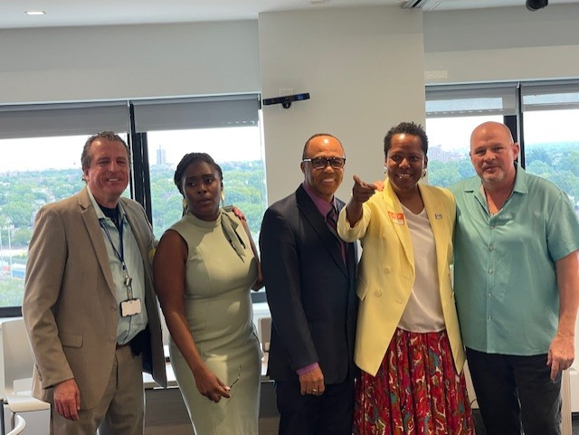
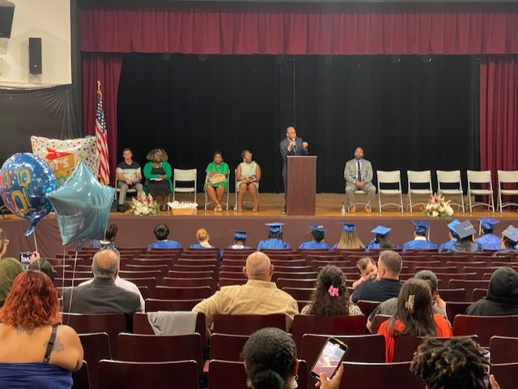
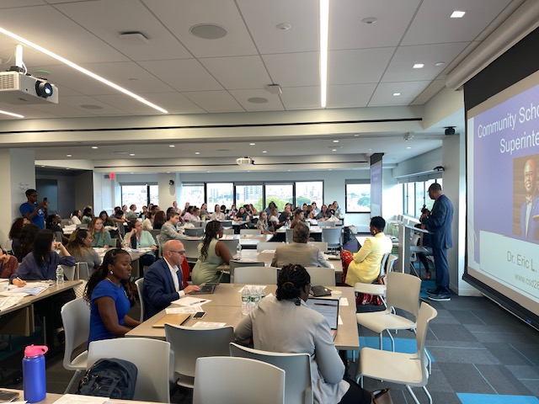
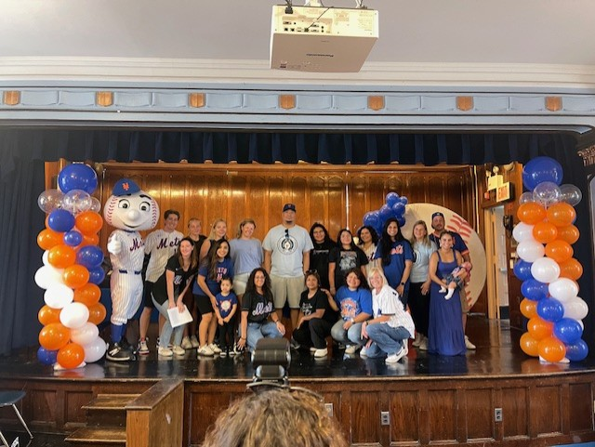
Literacy Proficiency
Math Proficiency
Chronic Absenteeism & Retention
Parent Engagement
Community
Superintendent
Dr. Eric L. Blake
Deputy Superintendent
Dr. Shonelle Hall
“With effort and support all schools can meet the needs of their students and help them achieve outstanding educational outcomes”

Slide 2
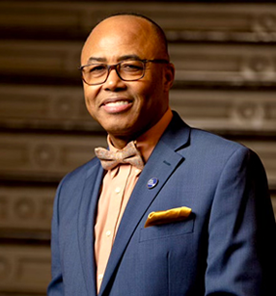
Welcome to the 2024-25 School Year!
Community Superintendent
Dr. Eric L. Blake

Slide 3
District 28 Vision, Mission & Goals
The United Nations' mission statement includes the line, "In this noble undertaking, cooperation, collaboration, unity, and solidarity must be the light we should seek and follow. we commit to strive for inestimable contribution to human progress."
Mission
In Community School District 28 we focus on equity as a lever for achievement for every single scholar. We are a district of excellence. We commit to every school maintaining high academic standards and working closely with families so that all scholars are learning at high levels. Beginning with school leaders, teachers, students and community partners, we also commit to being a district of learners ensuring that we promote critical thinking rooted in core content conceptual understanding through creative problem solving, technology innovation, social emotional learning and community advocacy.
Vision
In Community School District 28 we celebrate our differences because we understand that woven into those differences is the knowledge that they offer us unlimited possibility to learn and expand our knowledge of and commitment to all humanity. We are beautifully diverse, varied; coming from countless racial, ethnic, language, and belief backgrounds. We commit to striving for inestimable contribution to the lives of our scholars.

Slide 4
Core Values
➢ All scholars can learn with adult support.
➢ Scholars learn in different ways and at different paces.
➢ Scholars should be challenged to be lifelong learners.
➢ The key aspect of education is developing optimally rounded scholars who think creatively and critically to make informed decisions and solve problems.
➢ Education enables individuals to be responsible, self-disciplined members of society.
➢ Cultural diversity enriches the educational experience for scholars.
➢ Education is a collaborative partnership with central DOE, staff, scholars, families, and resources in the community.
➢ A safe and caring environment is important to scholars and staff.

Slide 5
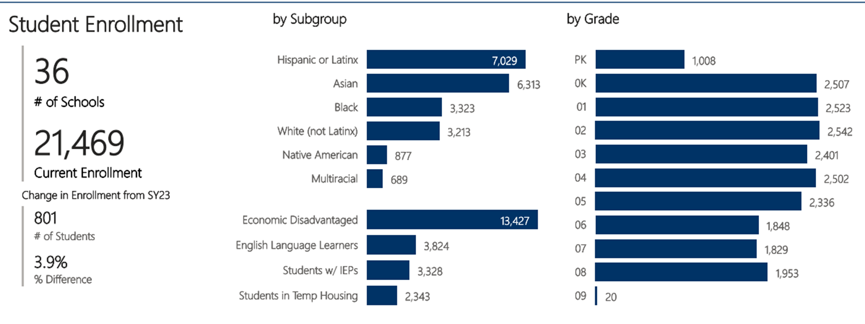

Slide 6
District Overview
Community School District 28 is located within Southern Queens, it is comprised of under 22,000 scholars. With respect to student body, 51% of our scholars are males and 49% are females. Demographically, we are also a diverse district. 4% of our scholars are American Indian or Alaska Native, 19% are Black or African American, 29% Hispanic / Latin X, 30% are Asians, 15% White, and 4% are Multiracial. Of the total number of students, 16% are Students with Disabilities, 65% are considered economically disadvantaged, 16% qualify for English Language Learner (ELL) services and approximately 6% of our students live in temporary housing.
In recent months, we continue to have an increase of migrant newcomer families which will further add to our diversity. This will also impact our need and ability to provide both educational and social emotional services. To some, this may be a challenge, however, with the support of our collective community, I view this an opportunity. Together, we will rise to the circumstances and continue to serve all scholars and their families with excellence.
We are comprised of 36 schools. Our families are actively engaged stakeholders. We have very active community and family leadership structures. These structures include Community Education Council, Community Boards, Presidents’ Council, several community leadership groups and richly collaborative partnerships with our Queens elected.

Slide 7
Superintendent Priorities:
Improve outcomes in mathematics by implementing a common research-based curriculum and introducing or scaling, where appropriate, Regents level courses for scholars
Improve literacy skills by implementing research-based, Science of Reading (SOR) HMH curriculum in all K-8 schools.
Work to substantially improve daily attendance and reduce chronic absenteeism.
Continue to increase Parent and Family Engagement and Community Partnerships.

Slide 8
ELA:
Outcomes 2023_2024:
54.5%, Decreasing – 3.6%
Still higher than city average at 49.1%
English Language Arts: 2024_25 DCEP Goal
By June 2025, District 28 will increase early outcome (English Language Arts) by 3 percentage points from 54.5 % to 57.5 % (English Language Arts) as reflected by New York State English language Arts assessment.
By June 2025, District 28 will increase early outcome (English Language Arts) for all Multilingual Learners by 3 percentage points from 8% to 11% (English Language Arts) as reflected by New York State English language Arts assessment.
By June 2025, District 28 will increase early outcome (English Language Arts) for all students with Individualized Education Plans by 3 percentage points from 23.5 % to 26.5% (English Language Arts) as reflected by New York State English language Arts assessment.

Slide 9
Mathematics:
Outcomes 2023_2024:
59.7%, increasing + 2.4%
Still higher than city average at 53.4%
MLLS: 4.4% increase in Math
SWI: 3.8% increase in Math
MATH DCEP Goals: 2024_25 DCEP Goal
By June 2025, District 28 will increase math outcomes by 3 percentage points from 59.7 % to 62.7%, as reflected by New York State Mathematics Assessment.
By June 2025, District 28 will increase math outcomes for all Multilingual Learners by 3 percentage points from 23.9 % to 26.9% as reflected by New York State Mathematics Assessment.
By June 2025, District 28 will increase math outcomes for all students with an Individualized Education Plan by 3 percentage points from 34.8 % to 37.8 % as reflected by New York State Mathematics Assessment.

Slide 10
Attendance:
Attendance Outcomes 2023_2024:
Overall Attendance: 90.70% vs 90.40%; IMPROVING + 0.3 overall
• Not only improving year over year, but also attendance above the city average of 89.6%
Overall Chronic Absenteeism: 37.20% vs 35.30%, DECREASING - 1.9 which represents a overall decrease of approximately 5.1% YAY!
2024_25 DCEP Goal:
By June 2025, we will increase district-wide attendance by 2 percentage points from 90.7% to 92.7% excluding students who are long-term international travelers.
By June 2025, we will reduce overall chronic absenteeism by 4 percentage points from approximately 35% to 31%, excluding students who are long-term international travelers.

Slide 11
Chancellor David C. Banks Class Size
NYS Class Size Reduction - NYCPS and UFT are working in conjunction with State partners to address
Citywide 40% meeting mandate
K-3: 20 or fewer students per class
4-8: 23 or fewer students per class
40% - 100% Compliance – Deputy Chancellor Weisberg
Need increased Space – Continue to build new schools
Highly Qualified Teachers (approximately 10-12K New Teachers needed Citywide to implement)
Need increased Funding
D28 has been working with Central, STH Regional Manager, Enrollment and schools directly to identify and meet the 3% D28 Target!
Summer 2024: Reduced class size in 16 schools totaling 62 classrooms districtwide to meet target in preparation for new year
Discussing new enrollment protocol to support keeping class size reductions as students are being enrolled across all schools
Due to large influx of families and current enrollment protocols, we may need to submit a waiver/exemption

Slide 12
New D28 Team Members
We are thrilled to welcome our new team members to the Superintendent’s Office! Their diverse talents and unique skills will be invaluable as we work together to support our school community.
Doris Castillo, ELA Implementation Specialist
Betina Severin, Literacy Specialist
LaVada Palmer, Reading Interventionist
Crystal Singletary Stone, Reading Interventionist

Slide 13
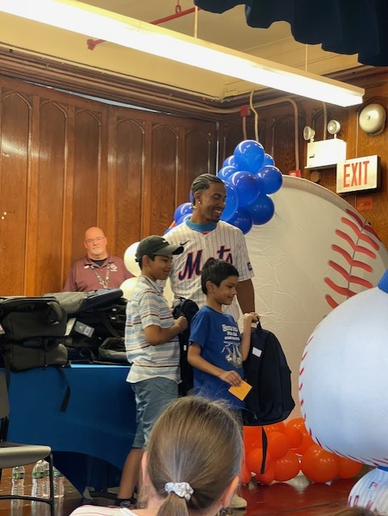
LET’S GO METS!!!
We are thrilled to announce that Mets player Francisco Lindor visited PS 54 on August 19, 2024, to generously give away 150 free backpacks to our Students in Temporary Housing (STH) families. This incredible act of kindness will not only provide essential supplies for our students but also inspire them with the support of a local sports hero. We are deeply grateful to Francisco Lindor and the METS organization for their commitment to our community.

Slide 14
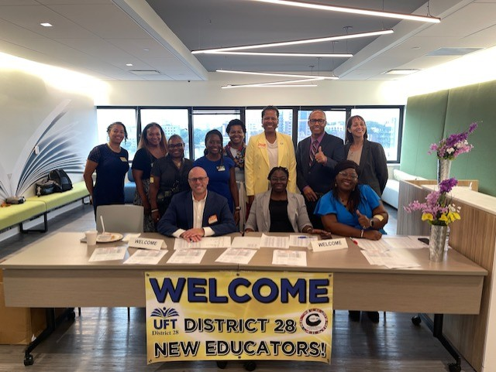
D28 Welcomes New Educators
Community School District 28 and the United Federation of Teachers are eager to welcome over 70 new educators tomorrow at District Welcome Day!

Slide 15
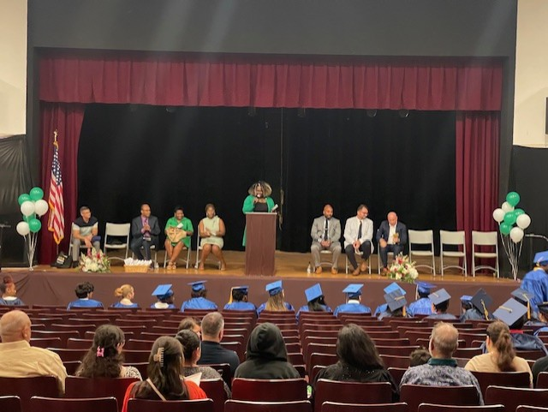
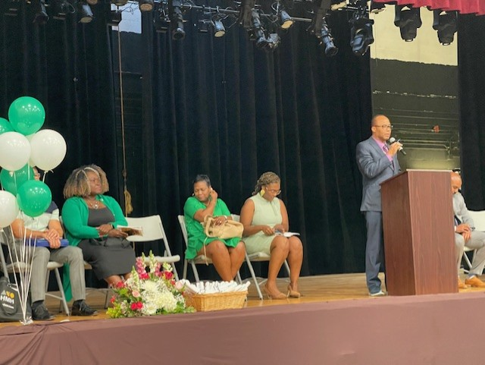
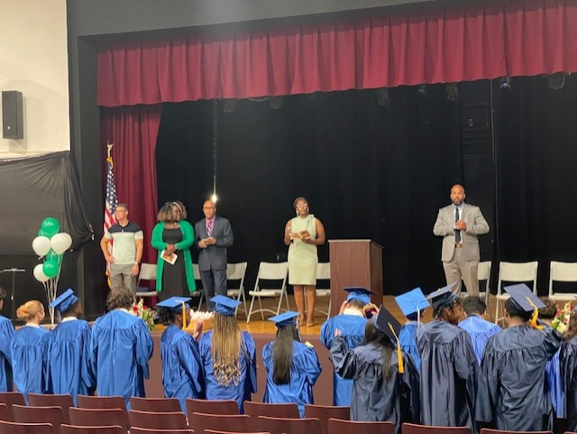
Summer Rising 8th Grade Graduation
Congratulations to our Summer Rising scholars on their 8th grade graduation! Your hard work, dedication, and resilience have brought you to this significant milestone. We are incredibly proud of each and every one of you and can’t wait to see all the amazing things you will accomplish in the future. Keep shining bright!

